Slide 1
assignment05 – Part 1 SkateRampArea

Slide 2
Read
assignment05 on volosin.lmu.build before you begin

Slide 3
Part 1
How to think about the problem

Slide 4

The purpose of this assignment is to estimate the area under a curve
The curve represents the Skate Ramp. We are looking for the area under the curve to see how much plywood we need to cover the side.
8
4
1
4

Slide 5

The purpose of this assignment is to estimate the area under a curve
The curve represents the Skate Ramp. We are looking for the area under the curve to see how much plywood we need to cover the side.
And to see how much space we have to sell advertising.
8
4
1
4

Slide 6
The purpose of this assignment is to estimate the area under a curve
To estimate the area, we are given the following pieces of information
A Function
Coefficients of x
Upper Bound
Lower Bound
Optional %
8
4
1
4

Slide 7
The purpose of this assignment is to estimate the area under a curve
To estimate the area, we are given the following pieces of information
A Function poly
Coefficients of x 1 8 -2
Upper Bound 4
Lower Bound 1
Optional % 1%
8
4
1
4

Slide 8
The purpose of this assignment is to estimate the area under a curve
To estimate the area, we are given the following pieces of information
A Function poly
Coefficients of x 1 8 -2
Upper Bound 4
Lower Bound 1
Optional % 1%
8
4
1
4

Slide 9
Given the function and the coefficients, we can write out the poly function as…
A Function poly
Coefficients of x 1 8 -2
Upper Bound 4
Lower Bound 1
Optional % 1%
8
-2x² + 8x + 1
4
1
4

Slide 10
How to use coefficients
A Function poly
Coefficients of x 1 8 -2
Upper Bound 4
Lower Bound 1
Optional % 1%
8
-2x² + 8x + 1
4
When we are given coefficients of x, assume that the first coefficient corresponds with x⁰, the second coefficient corresponds with x¹, the third coefficient corresponds with x² and so on
1
4

Slide 11
Graphed
A Function poly
Coefficients of x 1 8 -2
Upper Bound 4
Lower Bound 1
Optional % 1%
8
-2x² + 8x + 1
4
1
This is the graph of this function
4

Slide 12
Upper and Lower Bounds
A Function poly
Coefficients of x 1 8 -2
Upper Bound 4
Lower Bound 1
Optional % 1%
8
-2x² + 8x + 1
4
The upper and lower bounds tell us between which 2 x values to find the area.
1
4
Lower Bound
Upper Bound

Slide 13
Find the area between the UB and LB and under the curve
A Function poly
Coefficients of x 1 8 -2
Upper Bound 4
Lower Bound 1
Optional % 1%
8
-2x² + 8x + 1
4
The upper and lower bounds tell us between which 2 x values to find the area.
1
4
Lower Bound
Upper Bound

Slide 14
We will circle back to the optional % later
A Function poly
Coefficients of x 1 8 -2
Upper Bound 4
Lower Bound 1
Optional % 1%
8
-2x² + 8x + 1
4
The optional percentage tells us
1
4
Lower Bound
Upper Bound

Slide 15
Part 2
Solving the problem

Slide 16
Let’s circle back to our first example
-2x² + 8x + 1
A Function poly
Coefficients of x 1 8 -2
Upper Bound 4
Lower Bound 1
Optional % 1%
8
4
1
4
Lower Bound
Upper Bound

Slide 17
Let’s circle back to our first example
-2x² + 8x + 1
A Function poly
Coefficients of x 1 8 -2
Upper Bound 4
Lower Bound 1
Optional % 1%
numRectangles 1
8.5
8
4
1
2.5
4
Lower Bound
Midpoint
Upper Bound

Slide 18
1 Rectangle
-2x² + 8x + 1
A Function poly
Coefficients of x 1 8 -2
Upper Bound 4
Lower Bound 1
Optional % 1%
numRectangles 1
8.5
8
ESTIMATE 1 | How | This problem
Find the length of each rectangle | length = ( ub – lb ) / numRect | ( 4 – 1 ) / 1 => 3
Midpoint of each rectangle | midpoint = lb + (( length / 2 ) * (rectNum*2)-1) | 1 + ((4 - 1) / 2 ) * ((1*2) -1) => 2.5
Find y coord ofeach midpoint on the curve | yCoord = function(midpoint) | -2(2.5)² + 8(2.5) + 1 => 8.5
Sum the area of each rectangle | length * yCoord | 3 * 8.5 => 25.5
4
1
2.5
4
Lower Bound
Midpoint
Upper Bound

Slide 19
2 Rectangles
-2x² + 8x + 1
numRectangles 2
ESTIMATE 2 | How | This problem
Find the length of each rectangle | length = ( ub – lb ) / numRect | (4 – 1) / 2 => 1.5
Midpoint of each rectangle | midpoint = lb + (( length / 2 ) * (rectNum*2)-1) | rectNum = 1 1 + ( (1.5/2) * 1 ) 1.75 rectNum = 2 1 + ( (1.5/2) * 3 ) 3.25
Find y coord of each midpoint on the curve | yCoord = function(midpoint) | rectNum = 1 -2(1.75)² + 8(1.75) + 1 8.75 rectNum = 2 2(3.25)² + 8(3.25) + 1 => 5.875
Sum the area of each rectangle | length * yCoord | rectNum = 1 1.5 * 8.75 13.3125 rectNum = 2 1.5 * 5.875 8.8125 22.125
8.75
8
5.875
4
1
2.5
4
Lower Bound
Midpoint
Upper Bound

Slide 20
Optional %
A Function poly
Coefficients of x 1 8 -2
Upper Bound 4
Lower Bound 1
Optional % 1%
numRectangles 1
previousArea = 25.5
currentArea = 22.125
8.5
8.75
8
8
5.875
4
4
1
2.5
4
1
2.5
4
Lower Bound
Midpoint
Upper Bound
Lower Bound
Midpoint
Upper Bound

Slide 21
Optional %
A Function poly
Coefficients of x 1 8 -2
Upper Bound 4
Lower Bound 1
Optional % 1%
numRectangles 1
previousArea = 25.5
currentArea = 22.125
8.5
8.75
8
8
5.875
If currentArea is within the optional % of previousArea, we are done!
=> Return currentArea as the area.
If currentArea is NOT within the optional % of previousArea
=> Move on to next iteration
Next Iteration
=> previousArea = currentArea;
=> Calculate currentArea with numRect + 1
Repeat until the currentArea is within % of previousArea
NOTE: If optional % is not provided in arguments, default to 1%
4
4
1
2.5
4
1
2.5
4
Lower Bound
Midpoint
Upper Bound
Lower Bound
Midpoint
Upper Bound

Slide 22
Optional %
A Function poly
Coefficients of x 1 8 -2
Upper Bound 4
Lower Bound 1
Optional % 1%
numRectangles 1
previousArea = 25.5
currentArea = 22.125
8.5
8.75
8
8
5.875
diffPercent = 1 – ( currentArea / previousArea );
diffPercent = 1 – ( 22.125 / 25.5);
diffPercent = .13
diffPercent <= percentDiff
.13 <= .01
=> FALSE
Move onto third iteration and repeat.
4
4
1
2.5
4
1
2.5
4
Lower Bound
Midpoint
Upper Bound
Lower Bound
Midpoint
Upper Bound

Slide 23
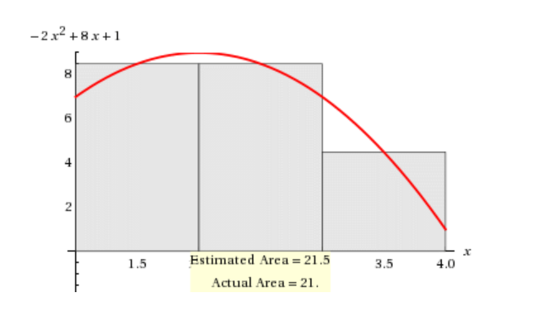
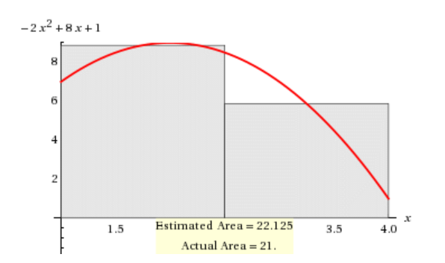
3 Rectangles
previousArea = 22.125
currentArea = 21.5
1 – ( 21.5 / 22.125 )
.02 <= .01
FALSE

Slide 24
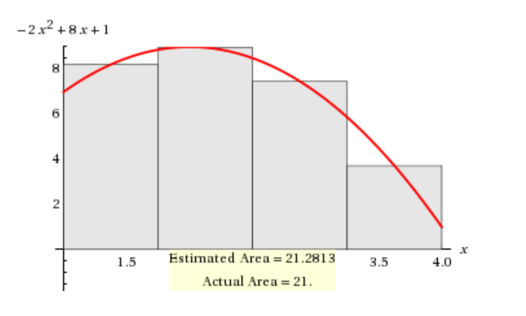
4 Rectangles
previousArea = 21.5
currentArea = 21.2813
1 – ( 21.2813 / 21.5 )
.0101 <= .01
FALSE

Slide 25
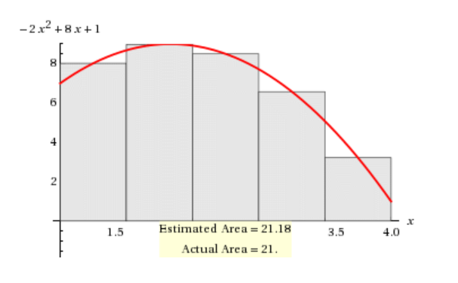
5 Rectangles
previousArea = 21.2813
currentArea = 21.18
1 – ( 21.18 / 21.2813 )
.004 <= .01
TRUE!!!!!

Slide 26
Area found!
The area under the poly curve,
Between 1 and 4 is 21.18 after using 5 rectangles
-2x² + 8x + 1
currentArea = 21.18

Slide 27
Part 3
Arguments for your program

Slide 28
SkateRampArea Arguments
If the last argument has a % sign in it, it is the optional percentage
If the last argument does not have a % sign in it, it is the upper bound
The argument before the upper bound is the lower bound
The first argument is the function
All other arguments are coefficients
java SkateRampArea poly 1 8 -2 1 4 1%
Function
Coefficients
Lower Bound
Optional %
Upper Bound

Slide 29
SkateRamp Arguments - Coefficients
java SkateRampArea poly 1 8 -2 1 4 1%
Function
Coefficients
Lower Bound
Optional %
Upper Bound
coefficients = [ 1, 8, -2 ];
x⁰
x¹
x²
-2x² + 8x + 1

Slide 30
SkateRamp Arguments - Coefficients
java SkateRampArea poly 0 0 -2 1 4 1%
Function
Coefficients
Lower Bound
Optional %
Upper Bound
coefficients = [ 0, 0, -2 ];
x⁰
x¹
x²
-2x²

Slide 31
Riemann Integration
This method of finding the area under the curve is called Riemann Integration.
You can check your work here –
http://mathworld.wolfram.com/RiemannSum.html

